Slide 1

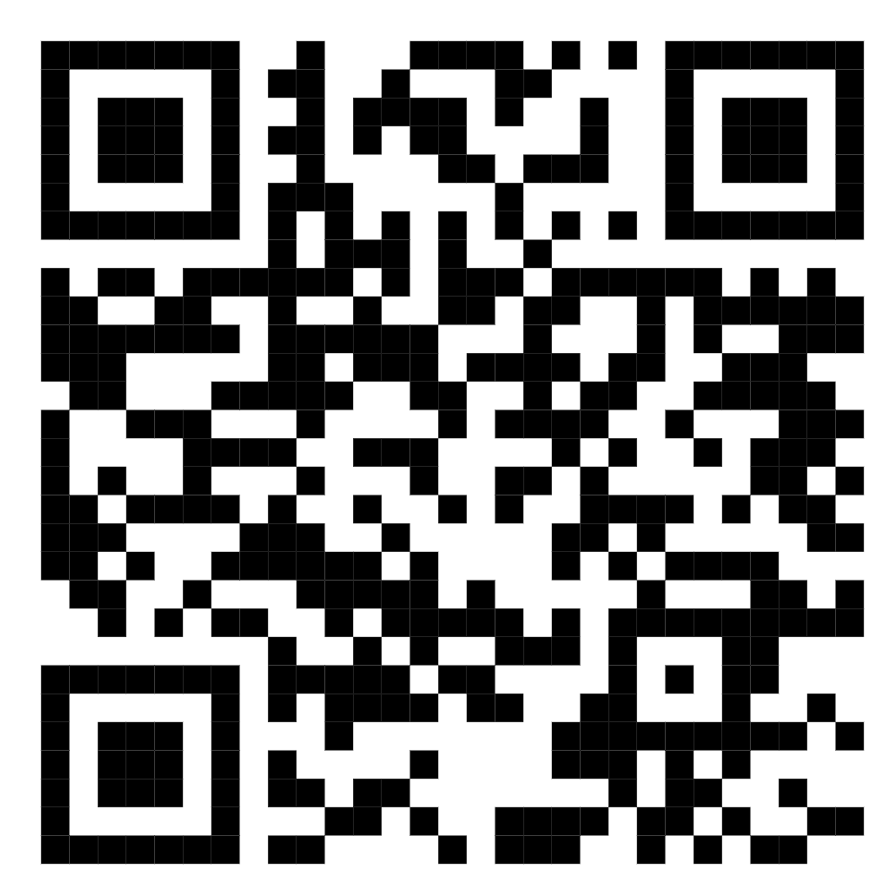
BECOME A
VOLUNTEER NOTE-TAKER!
Share your notes with students registered with Accessibility Services
and help them achieve academic success.
Get a certificate of appreciation, CCR credit and be entered to win a gift card!
To learn more, visit uoft.me/notetaking or email your questions to as.notetaking@utoronto.ca
Scan the QR code to sign up.

